Slide 1
Fida-Ghana activities 2022-2024

Slide 2
Transformative action on gender equality (TAGE) project
Summary of Project
A 30 month partnership between FIDA-Ghana and Action Aid Ghana (2021-2024)to empower 6,400 women and girls most at risk from gender-based violence to know their rights, to understand and recognize all forms of domestic violence. It was intended to also seek protection for women with disabilities and defend themselves, within 64 communities of four regions in the country.
Activities included tracking the 2022, 2023 and 2024 National budgets to advocate for increased resources to the Ministry of Gender and the Domestic Violence Fund, which the ministry has oversight of.

Slide 3
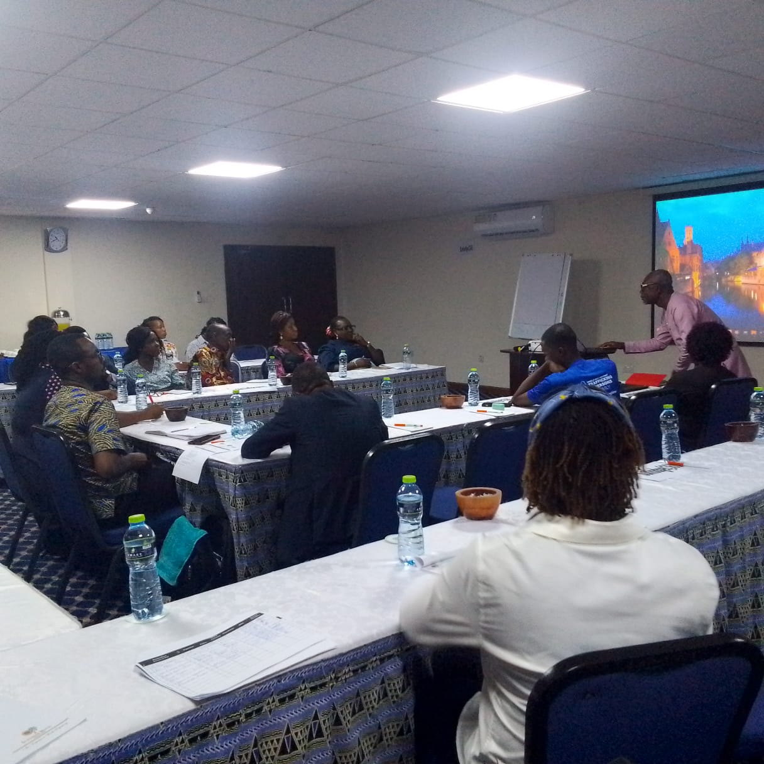
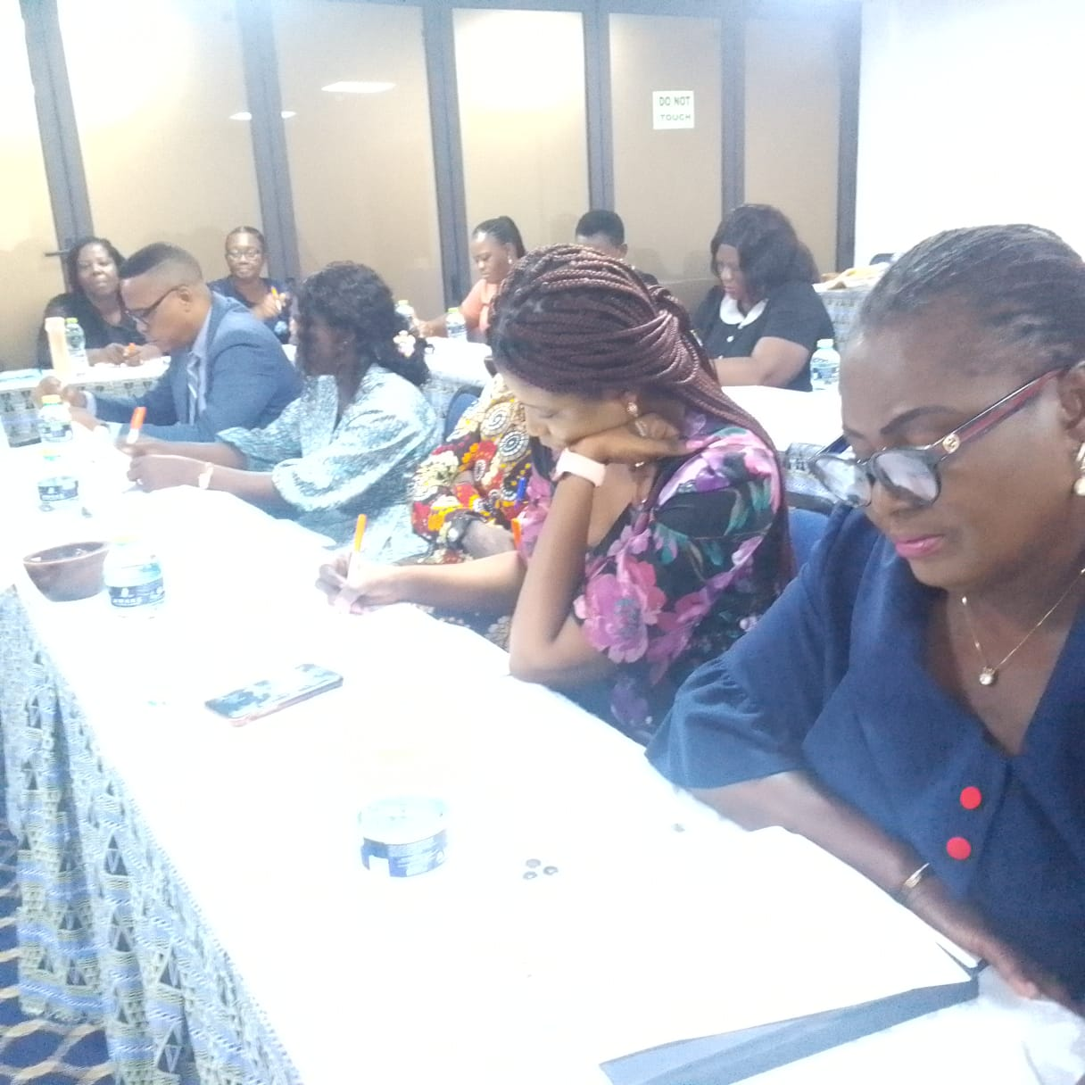
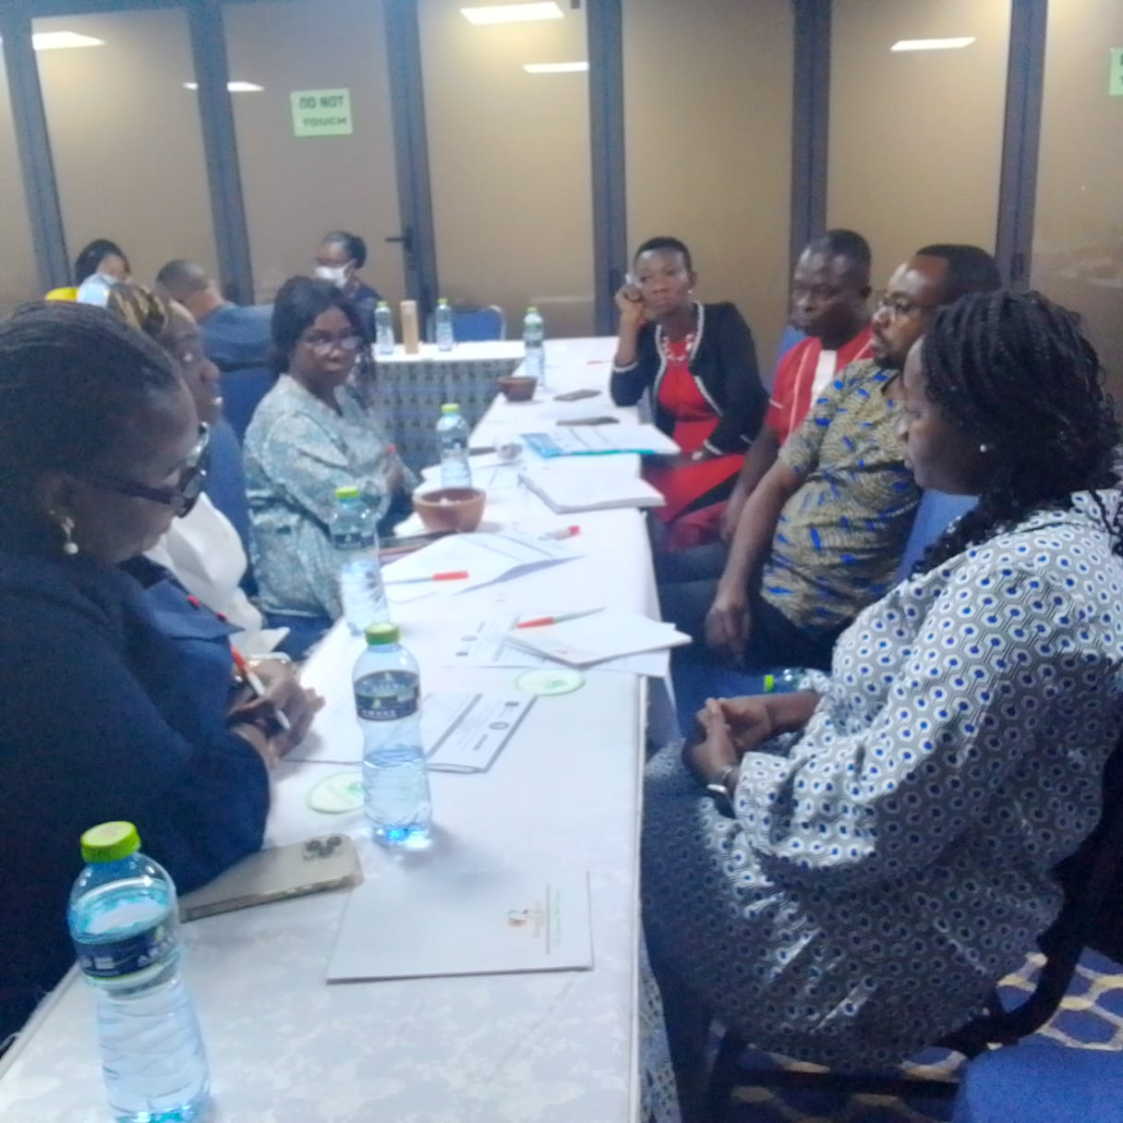
TAGE PROJECT
Researcher sharing results of analysis of 2023 & 2024 National budget

Slide 4
Impact of budget ANALYSIS
An increase of funds to the Gender ministry by x% , the DV fund by 0.5% from 0.12%. Gaps still exist in the delays of allocation but it is a good start and has provided FIDA Ghana with new areas for increased advocacy.
The increased funding has provided more resources for to provide training for staff of the Gender ministry and the DV secretariat under the ministry of gender’s supervision.
Expanded support services has been made available to survivors of domestic violence including psycho- social services

Slide 5
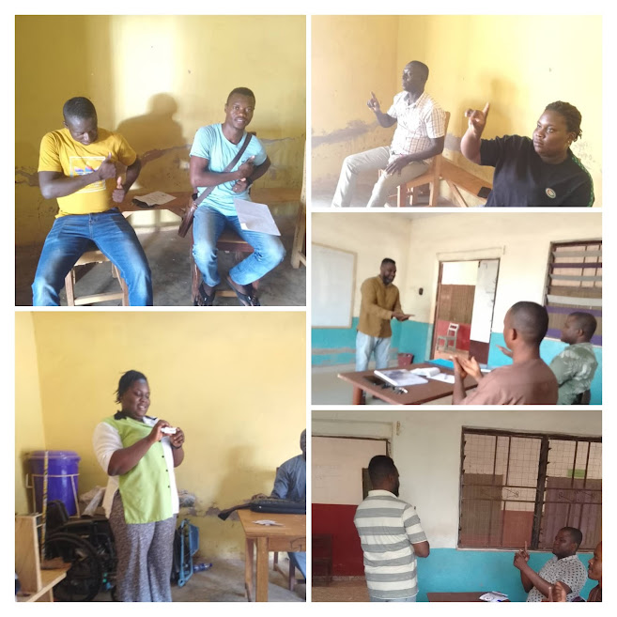
Sign language training pictures of law enforcement officers

Slide 6
IMPACT OF SIGN LAnGUAGE TRAINING
SIGN LANGUAGE INSTRUCTION- This was an innovation of the project to ensure that law enforcement officers are disability aware and have the relevant skills to provide targeted services for women and girls with disabilities.
According to one officer
“This has been very instructive, as it has enhanced our skill to communicate at a basic level with both women and men with disabilities” (DOVVSU Staff, Volta region.)
Finally it has promoted diversity and inclusivity in the practices of Law enforcement agencies.

Slide 7
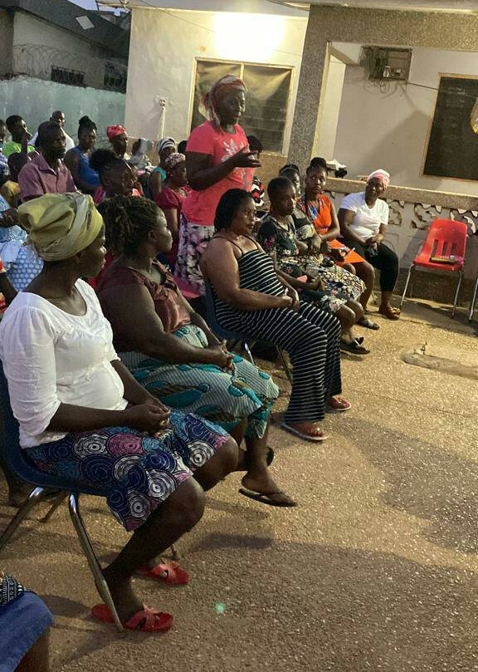
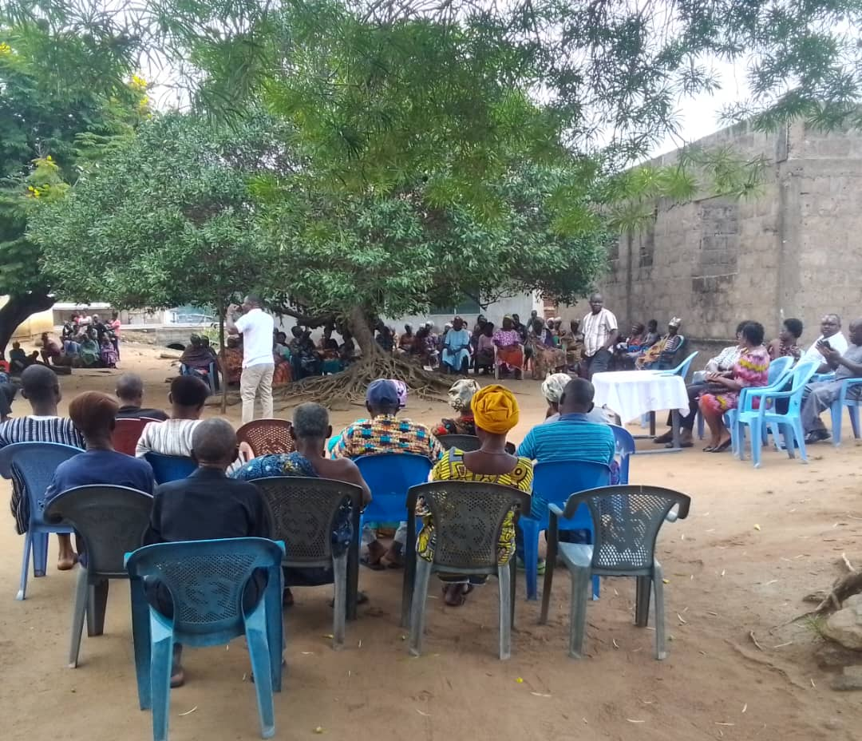
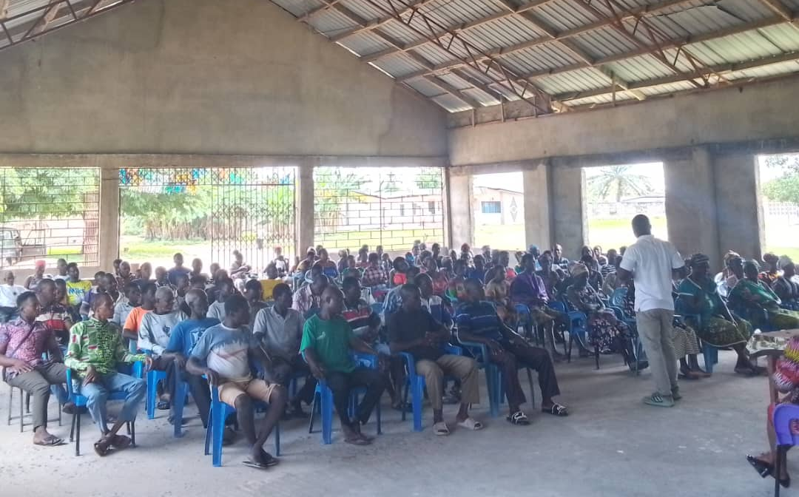
Community outreaches in the communities

Slide 8
IMPACT OF COMMUNITY OUTREACHES
Community outreaches have always been one of FIDA Ghana’s strategic approaches to increase awareness of legal rights and avenues to access justice. The target of reaching 6,400 was exceeded by forty percent, as community response teams were able to use their own initiatives to reach out to other communities outside the targeted intervention sites.
“ I was glad that the community teams were able to bring information to our doorsteps” As I shared my challenge of my husband’s refusal to provide child care support for my three children, one with disability, the team members visit to our home, and the education provided to my husband has brought a change in attitude.” My children are now enrolled in school and my daughter who is deaf is now in a special needs school.” (Community member, Adaklu Volta Region.

Slide 9
CHANGE STORIES
CHILD SUPPORT PROVIDED FOR 2 YEAR OLD
A girl aged 22 years had a child aged 2 years and the man never named the child even though the man showed up during pregnancy to claim responsibility. Since then, he has never taken care of the child. Her case was to be referred to Social Welfare.
At the Social Welfare office, the woman was told that since the father had been present during the pregnancy and claimed responsible, he is also legally responsible for providing financial support for the child. He must pay a monthly fee to the single mother to cover major expenses for taking care of the child.
Unfortunately, the man refused to pay the maintenance fees owed to the woman and her child.. The community responsive teams followed up on the case until the Social welfare officer, himself a trained community responsive team member decided to take the matter to Court. The court ruled that the man must pay a minimum of Ghs 300 monthly for the care of the child subject to review.
Now, with adequate support, the woman is able to complete more daily tasks and take proper care of her child. She is able to buy supplies, and save some money for the child’s education as well.
WOMAN RECEIVES
Hajia visited FIDA to complain that her husband who resides in the US had refused to maintain her and their daughter because she reported her stepson to the police for stabbing her daughter’s hand with a knife. Hajia was the second wife of her Muslim husband and had assisted her husband to construct a 6 storey apartment.
She reported that her husband was so angry at her for reporting the case to the police that he refused to accept paternity of their daughter and stopped maintaining them since the incident took place two years ago.
When the invitee (husband) was invited to FIDA he refused to accept the child they both have as his. FIDA referred the case to court, and the court ordered that a DNA test be done. The results proved that the daughter was indeed theirs. He was ordered to begin paying child support from the time he stopped making the payments two years ago.
After this. the case was referred to court again for Hajia Asia since invitee insisted that he no longer wanted her as his wife and was ejecting her from their family home.
Hajia was assisted by the Legal Aid officer to claim part of the property as she had devoted her time to supervising the construction of the building and could not have held down a job. The court ruled in favor of Hajia and ruled that she be given 500 million Ghana cedis, and an apartment. In her own words she gave testimony that “FIDA had done so well for her, I did not have any money, but the FIDA lawyer assisted me paying for filing all the necessary court documents.” “Now I have a house and some funds that can cushion me for some time whilst I set myself up in business.”

Slide 10
SAFE PROJECT
GBV/ Domestic violence in the fishing communities.
This was the first time that FIDA Ghana was supported under a USAID project known as the Ghana Fisheries Recovery Activity to address Domestic violence, child labor and child trafficking in selected fishing communities.
The SAFE project responded to the worsening incidence of GBV in selected fishing communities and districts due to deteriorating catches experienced within the fishing communities. Evidence based information highlights the vulnerability of female partners of men often with multiple partners to GBV/DV. Furthermore, child labor and trafficking have long been challenges characteristic of fishing communities, putting both young girls and boys at risk.

Slide 11
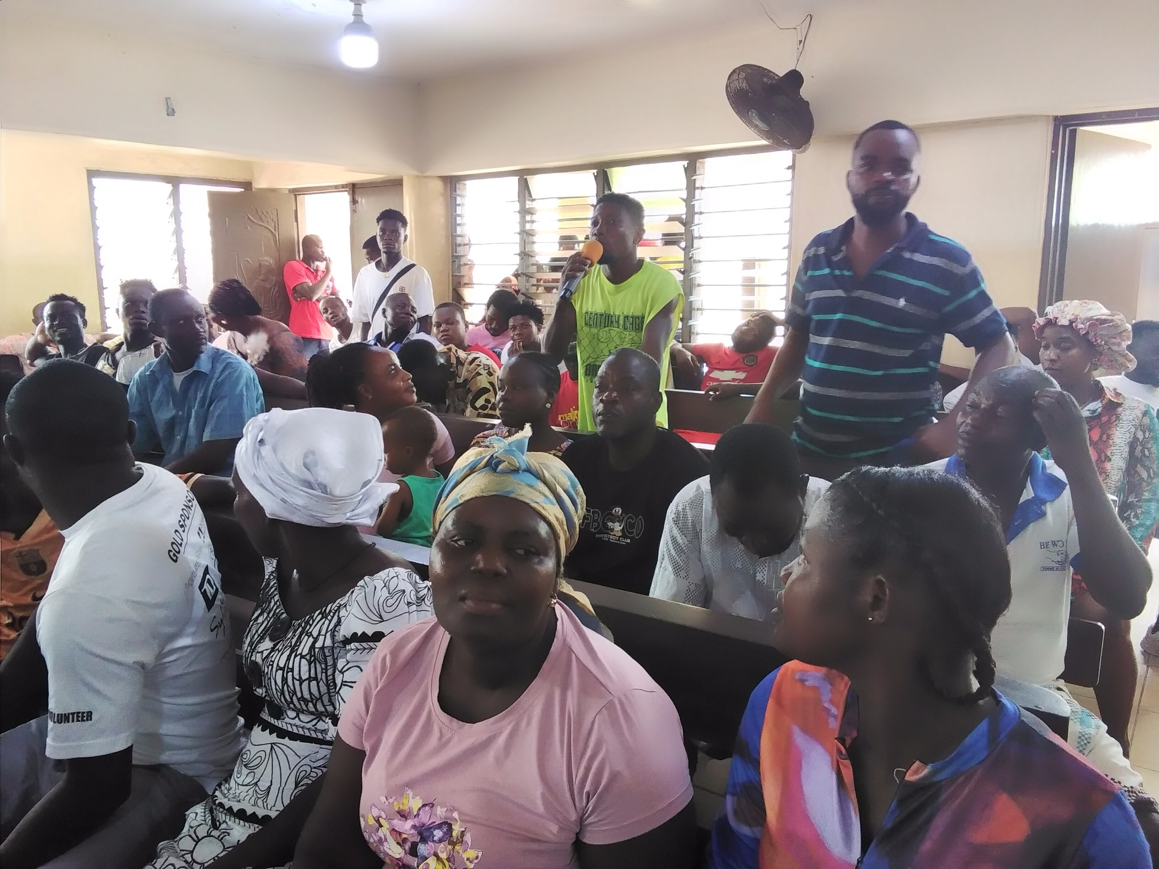
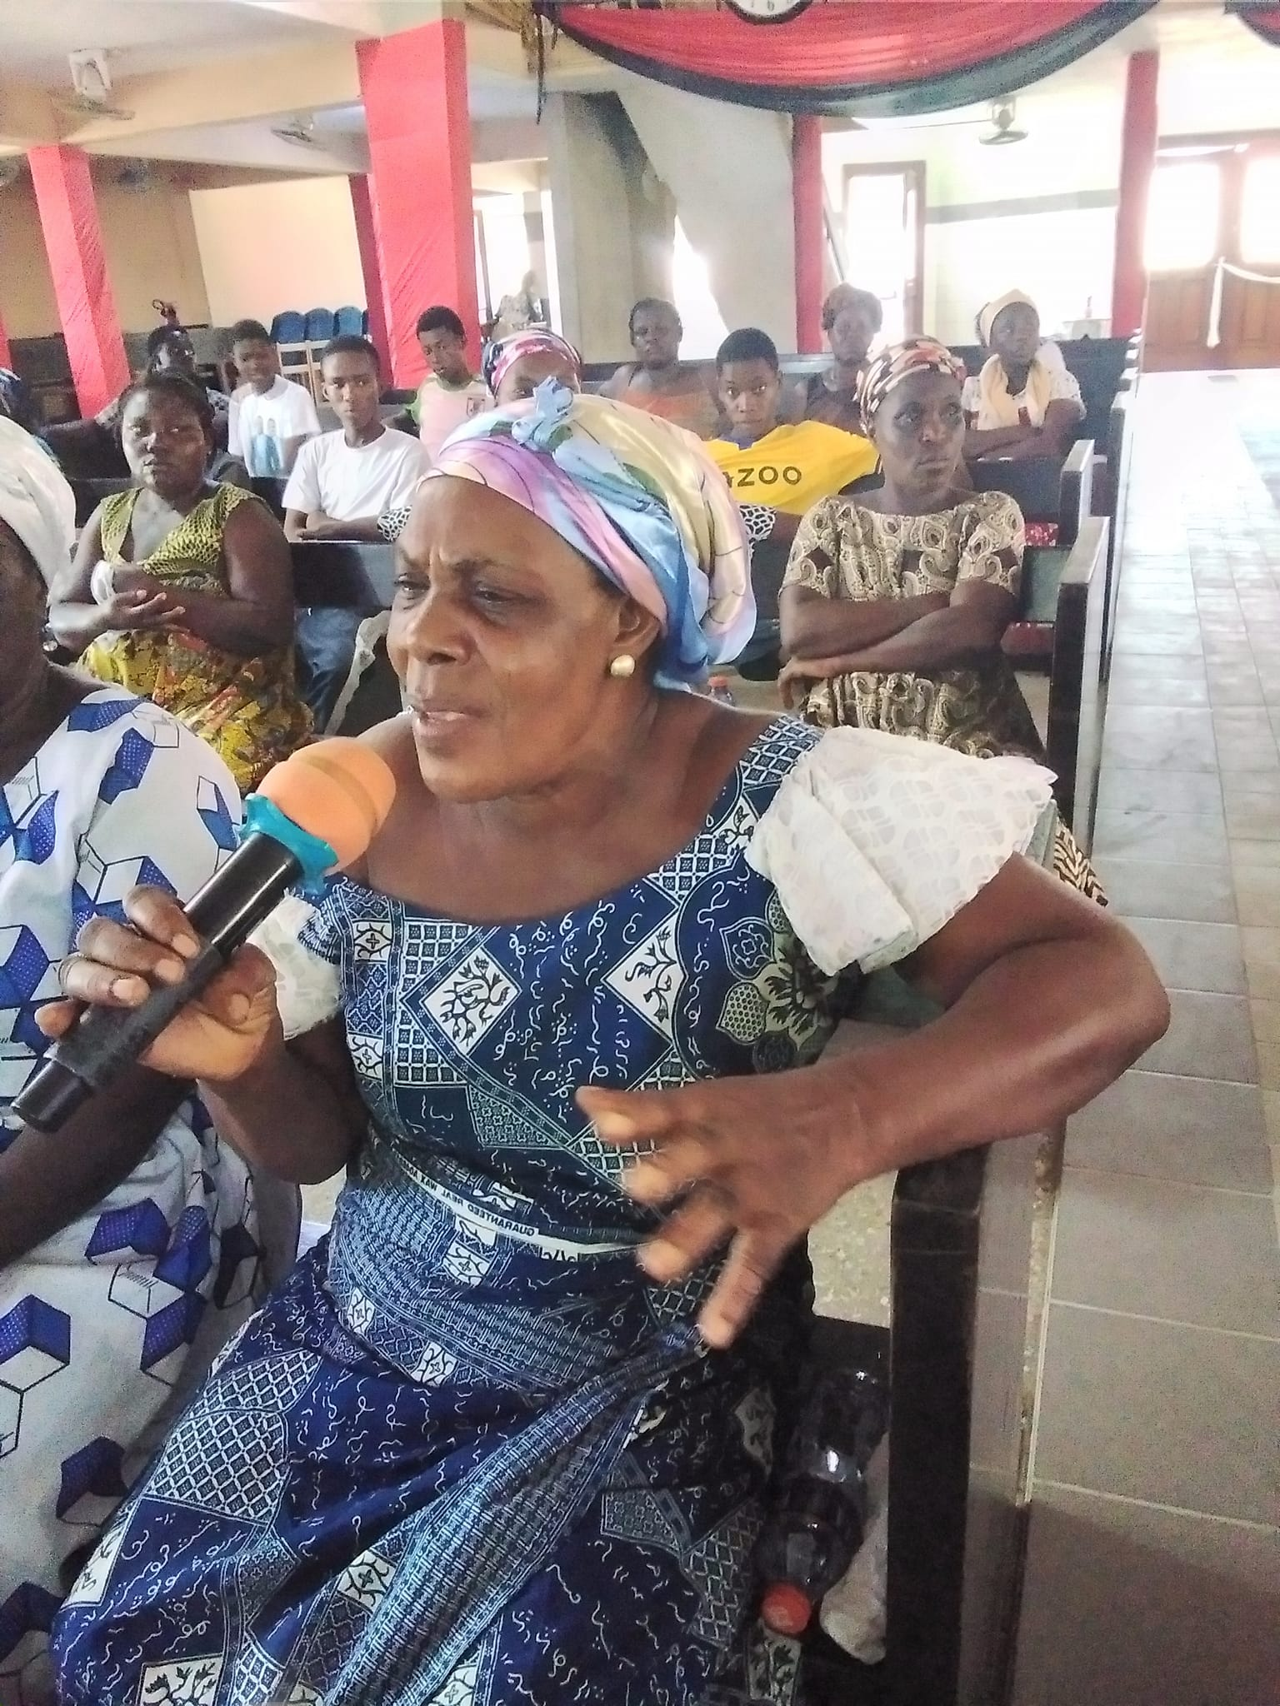
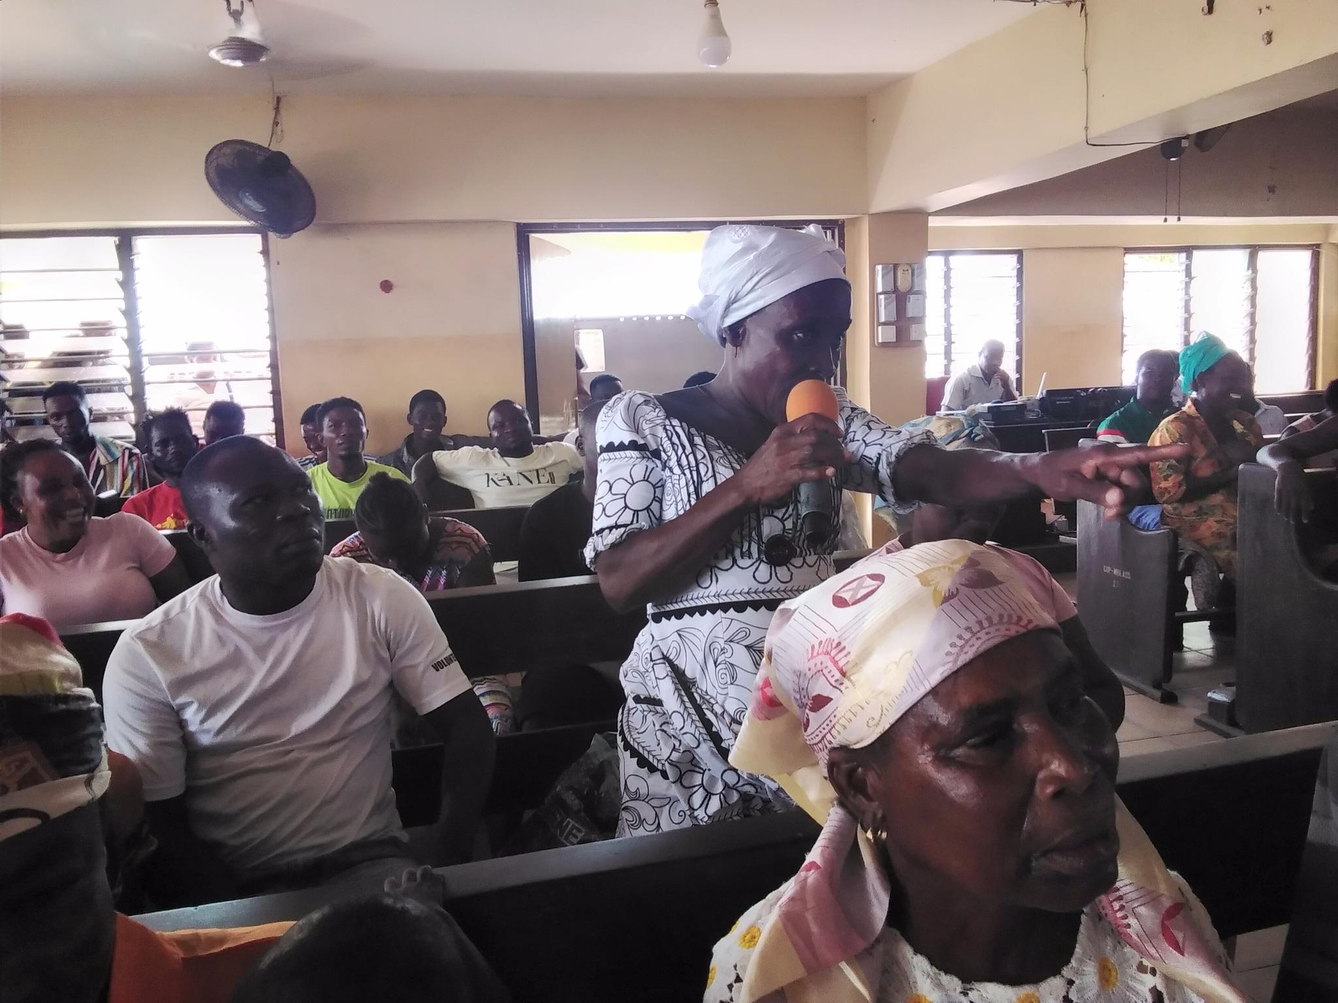
COMMUNITY OUTREACH
Conversations around GBV/DV and child labor /Child trafficking in the fishing communities in the Volta & Greater Accra region

Slide 12
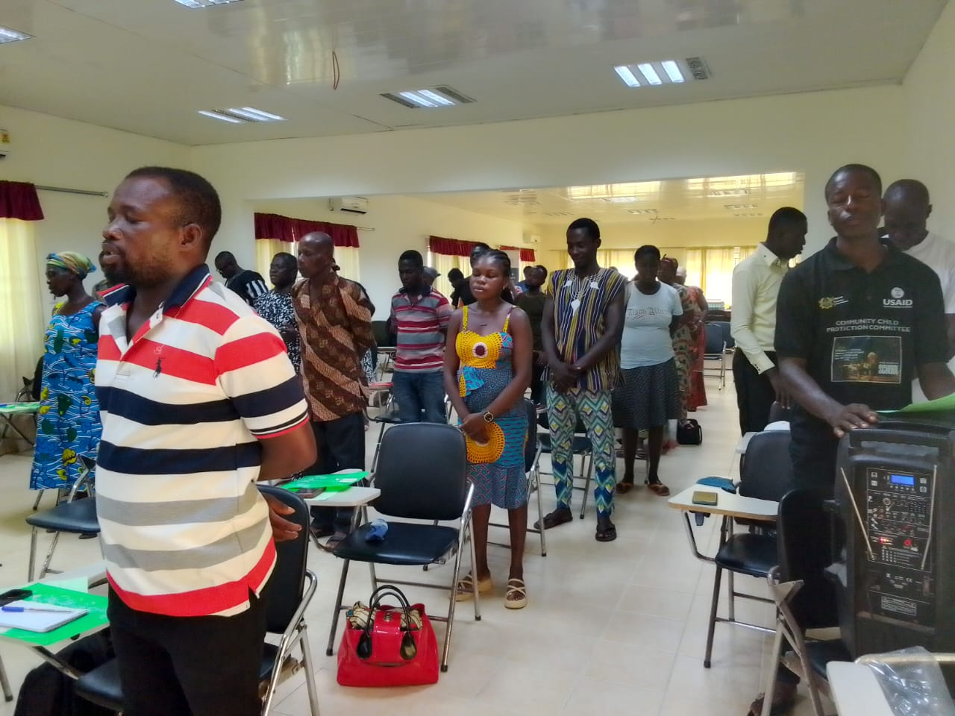
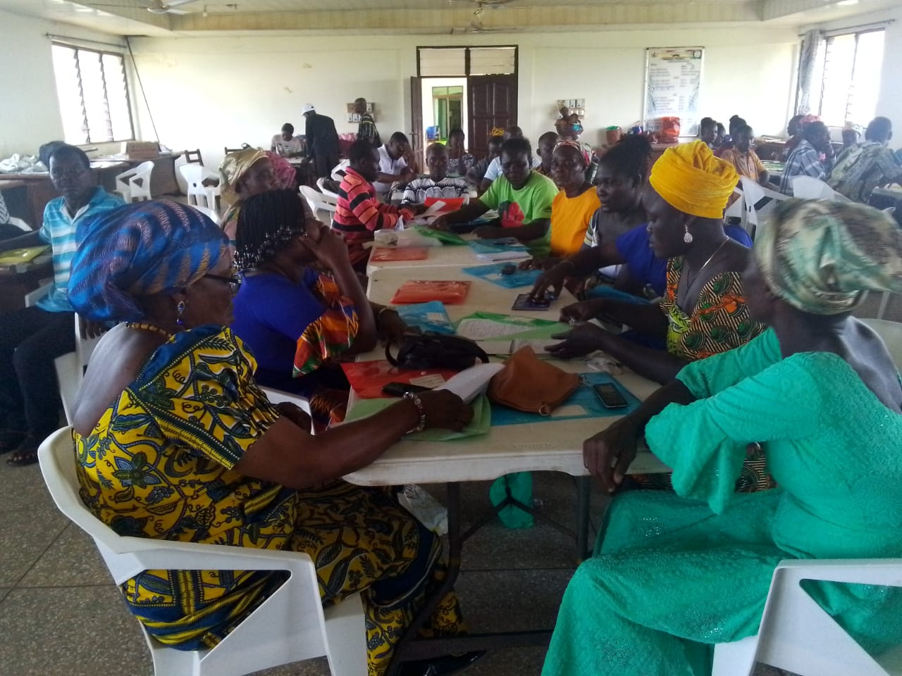
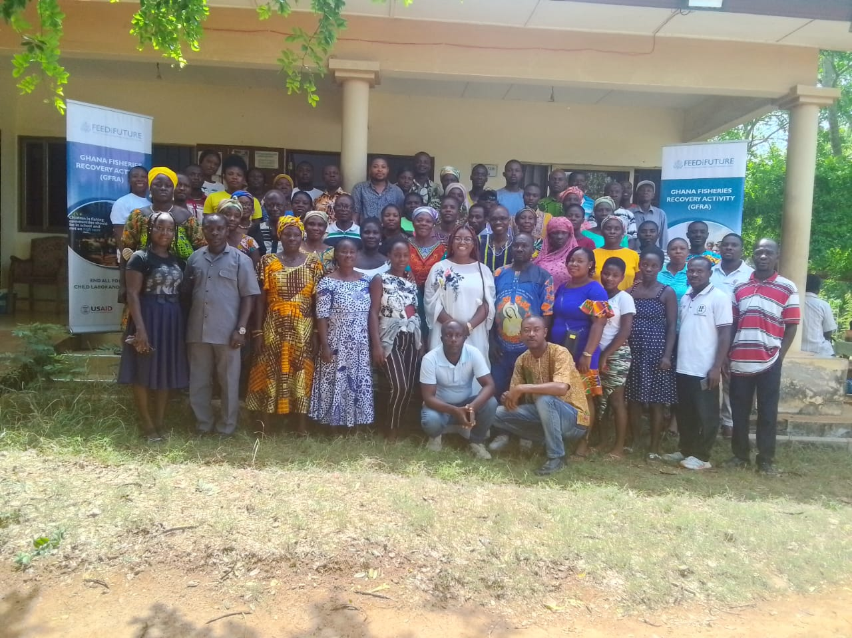
Community trainings
Empowering Child Community Protection Committes to address child lobor and Domestic Violence in fishing communities

Slide 13
IMPACT OF ACTIVITIES
Increased awareness of the laws and consequences of child labor/ child trafficking.
These spirited conversations, helped communities to identify strategies that could be introduced to reduce this practice.
One fisher man proposed the construction of specialized training schools from primary to secondary level in the fishing communities to provide instruction on scientific approaches to fishing.
Another proposed that teenage children be provided with a card akin to a driving license that will ensure that children are not trafficked and exploited to engage in fishing that will endanger their lives and halt their education.

Slide 14
IMPACT OF ACTIVITIES II
There was a total of 150 reported cases of domestic violence, which indicated an increase in reporting of cases of DV.
Community Protection teams reported a reduction of incidence in some communities as a result of their intervention.
Over 6,000 women, men, net owners, canoe owners and women in the fish smoking business benefited from the community activities.
There has been an increased awareness of the issues of Domestic violence in the targeted communities of Greater Accra and Volta region on the importance of community support for survivors of domestic violence.

